Slide 1
Semiconductor Memories

Slide 2
Introduction
Memory: Any system which processes digital data needs a facility for storing the unprocessed, partially processed and completely processed data is know as memory
In earlier days the memory used to be a magnetic tapes
But now a days we use semiconductor memories of various types and size.
Advantages of Semiconductor Memory
Small Size
High Speed
Better Reliability
Low Cost
Ease of expansion of memory

Slide 3
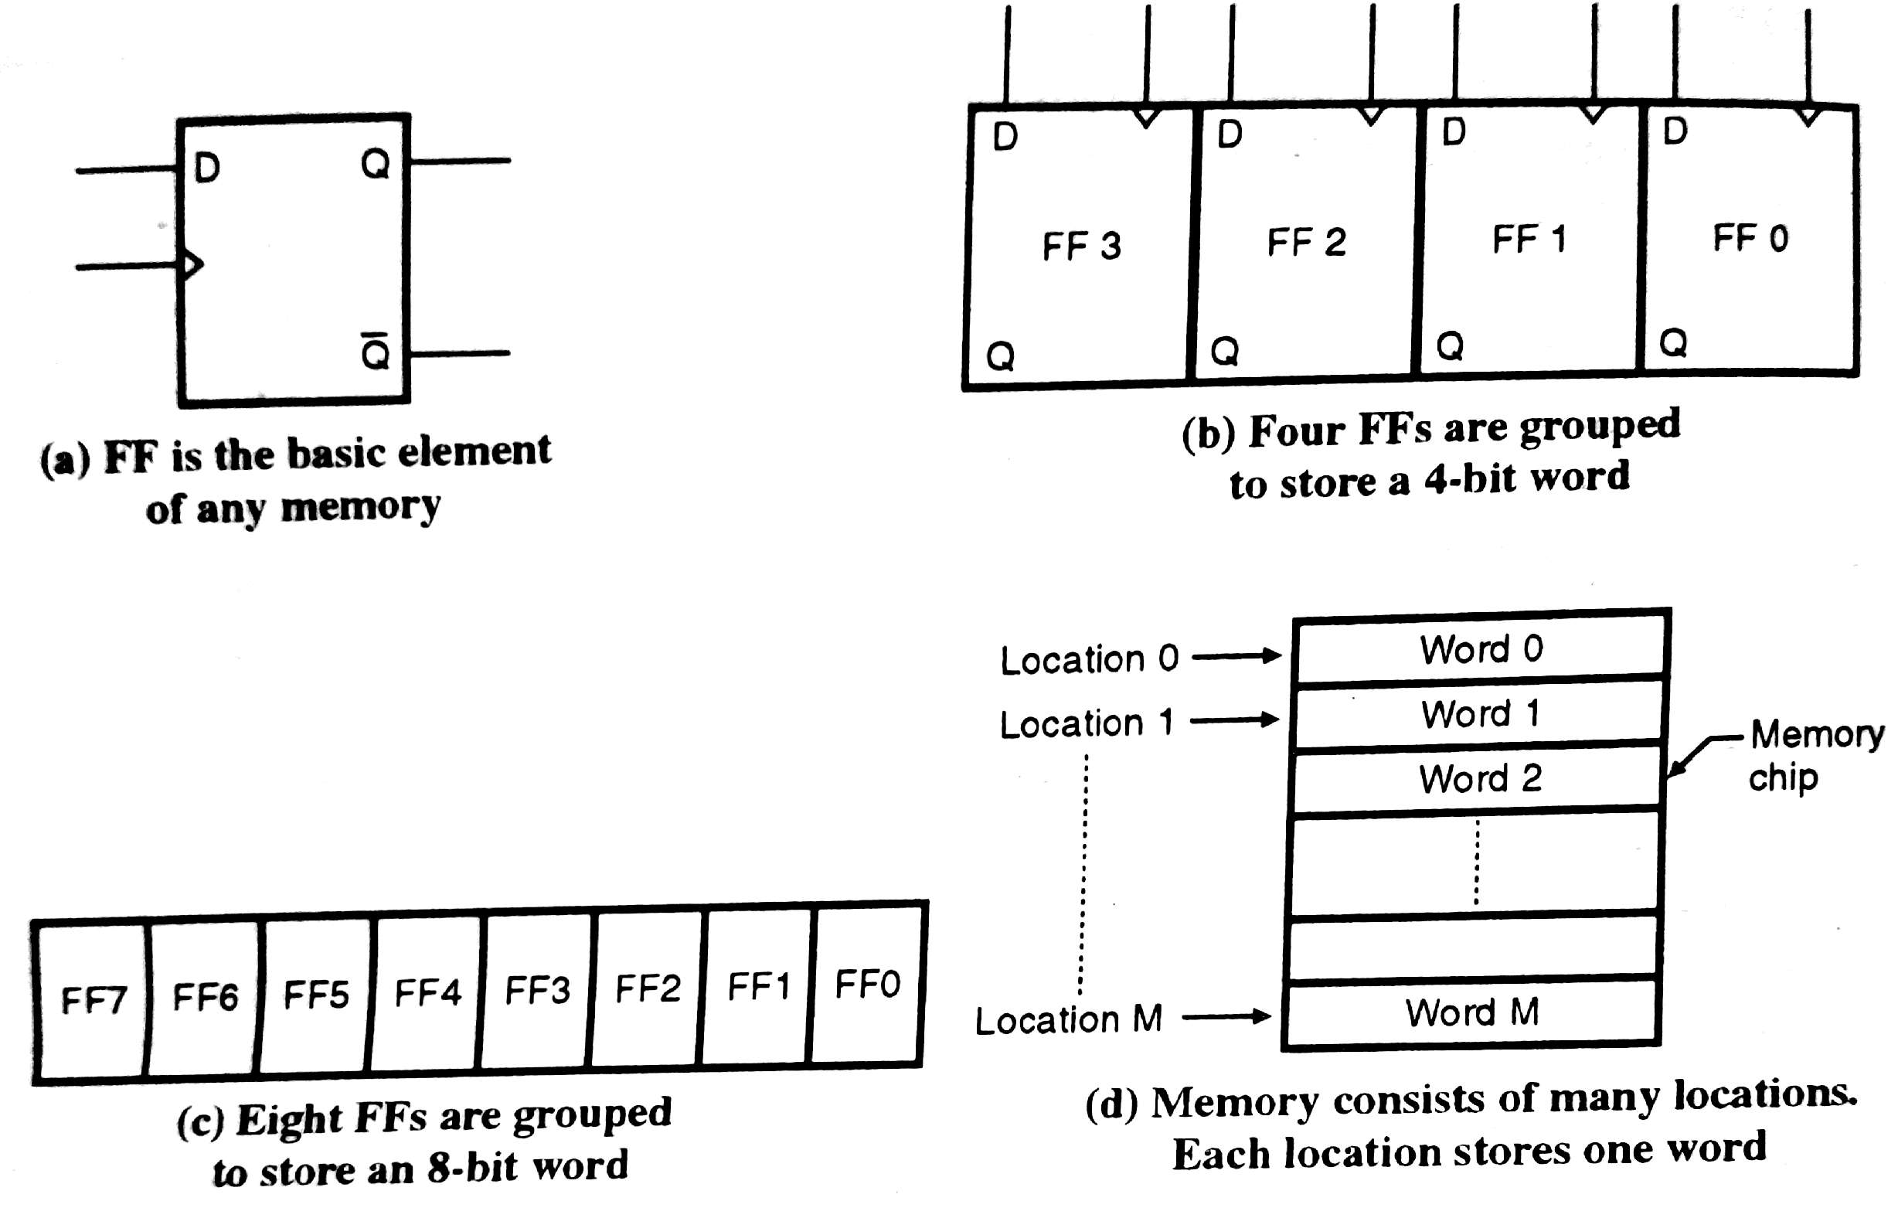
Memory Organization
Flip Flop is capable of storing single bit so the basic element of a semiconductor
memory is Flip – Flop
To Store a 4 –Bit word we need to use Four Flip Flops
There are a number of locations in a memory with each location storing a word
of required length

Slide 4
Memory Size
If a particular memory chip is capable of storing M words with each word having N bits in it then the size of the memory will be M x N
So if the size of memory chip is specified a 16 x 4 then it means that this memory consists of 16 locations and each location can store 4 – bit word.
The commonly used values of number of words per chip are 64, 256, 512, 1024, 2048, 4096 etc. and the common word size are 1, 4 and 8.

Slide 5
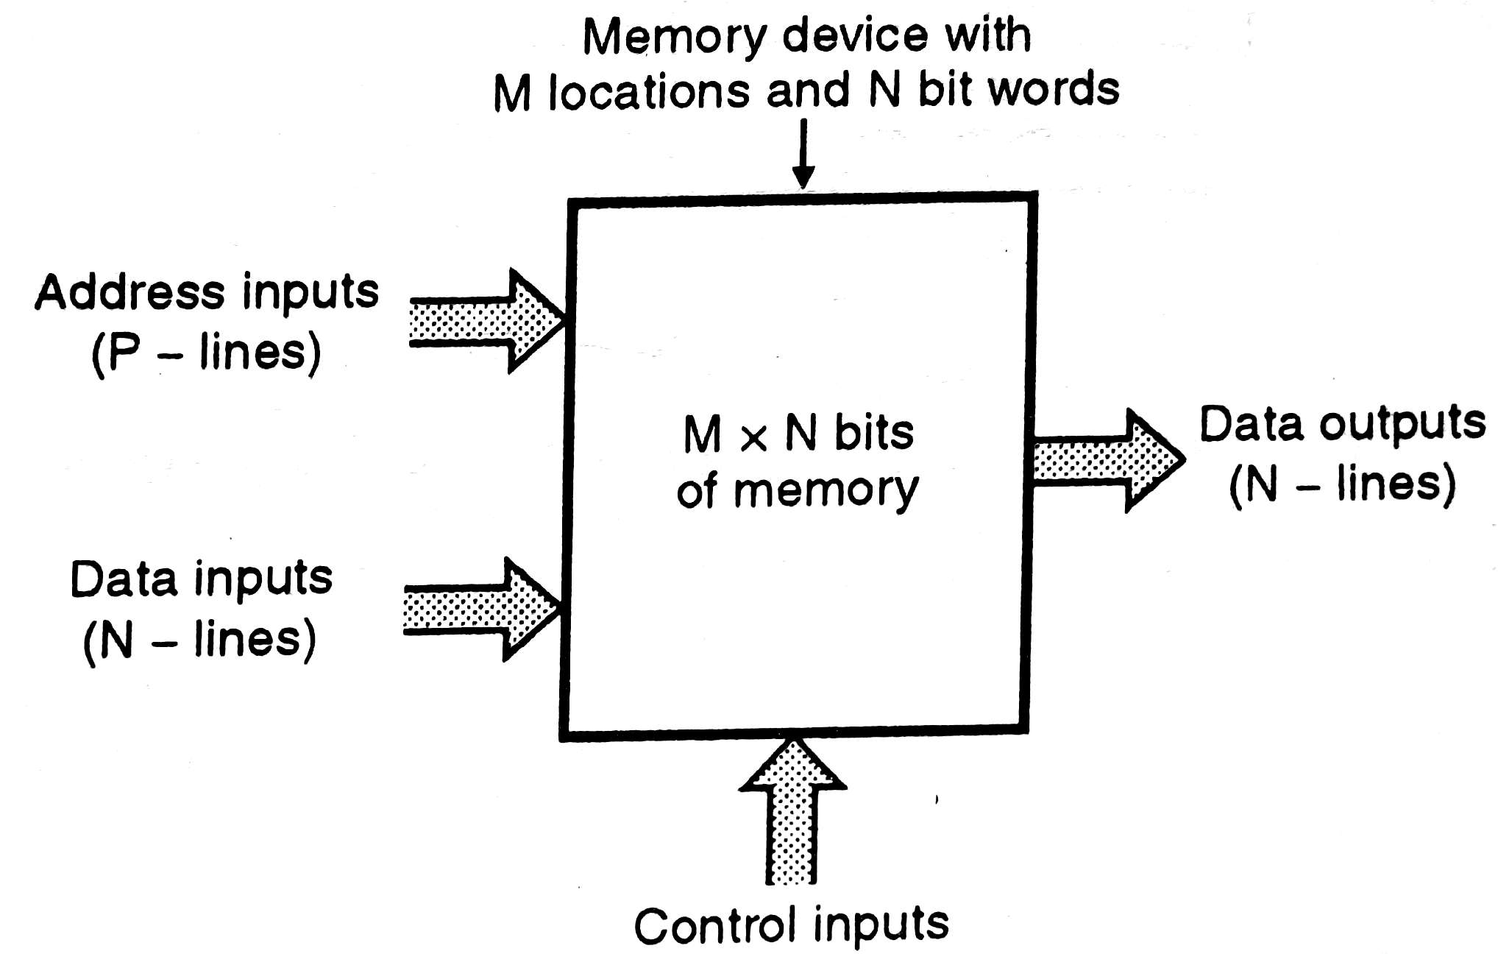
Block Diagram of Memory Device

Slide 6
Types of Inputs Lines and Output Lines
There are three types of inputs to an M x N memory Device
Address Input Lines or address Bus
Data Input Lines or Data Bus
Control Inputs
and there are N number of data output lines or Output data bus.
Data Input Lines: There are N – number of data input lines. The data to be stored is put on these lines word by word each word N – bit long.
Address Input Lines: There are ‘P’ number of address input lines. These lines are used to specify the ‘address’ of the required memory location, for reading the already stored data or writing a new data.
Data Output Lines: The data available in the selected memory location can be “read” on the data output lines. The number of data lines is N i.e. equal to the number of bits per word.
Input and output data buses are unidirectional. That means the data flows only in one direction.
In most of memory chips the same set data lines is used for data input as well as data output. Such data bus is called as Bi – directional data bus

Slide 7
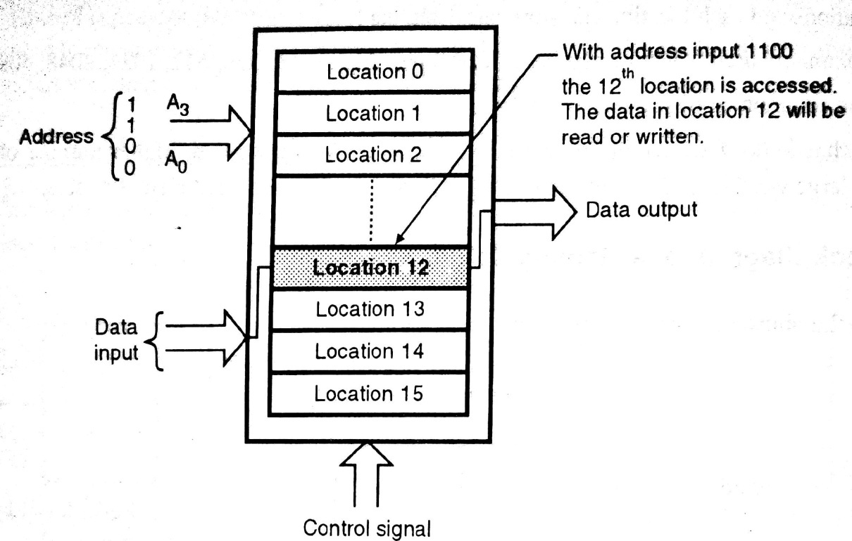
Selection of Location using address lines
To access any one of the M possible locations, we need P address lines such that
For example if M = 16 locations, then P = 4, So we need 4 address lines to have sixteen different combinations from 0000 to 1111.
If address inputs 1100 i.e. 12 then we will able to access the twelfth location of the memory chip as shown bellow

Slide 8
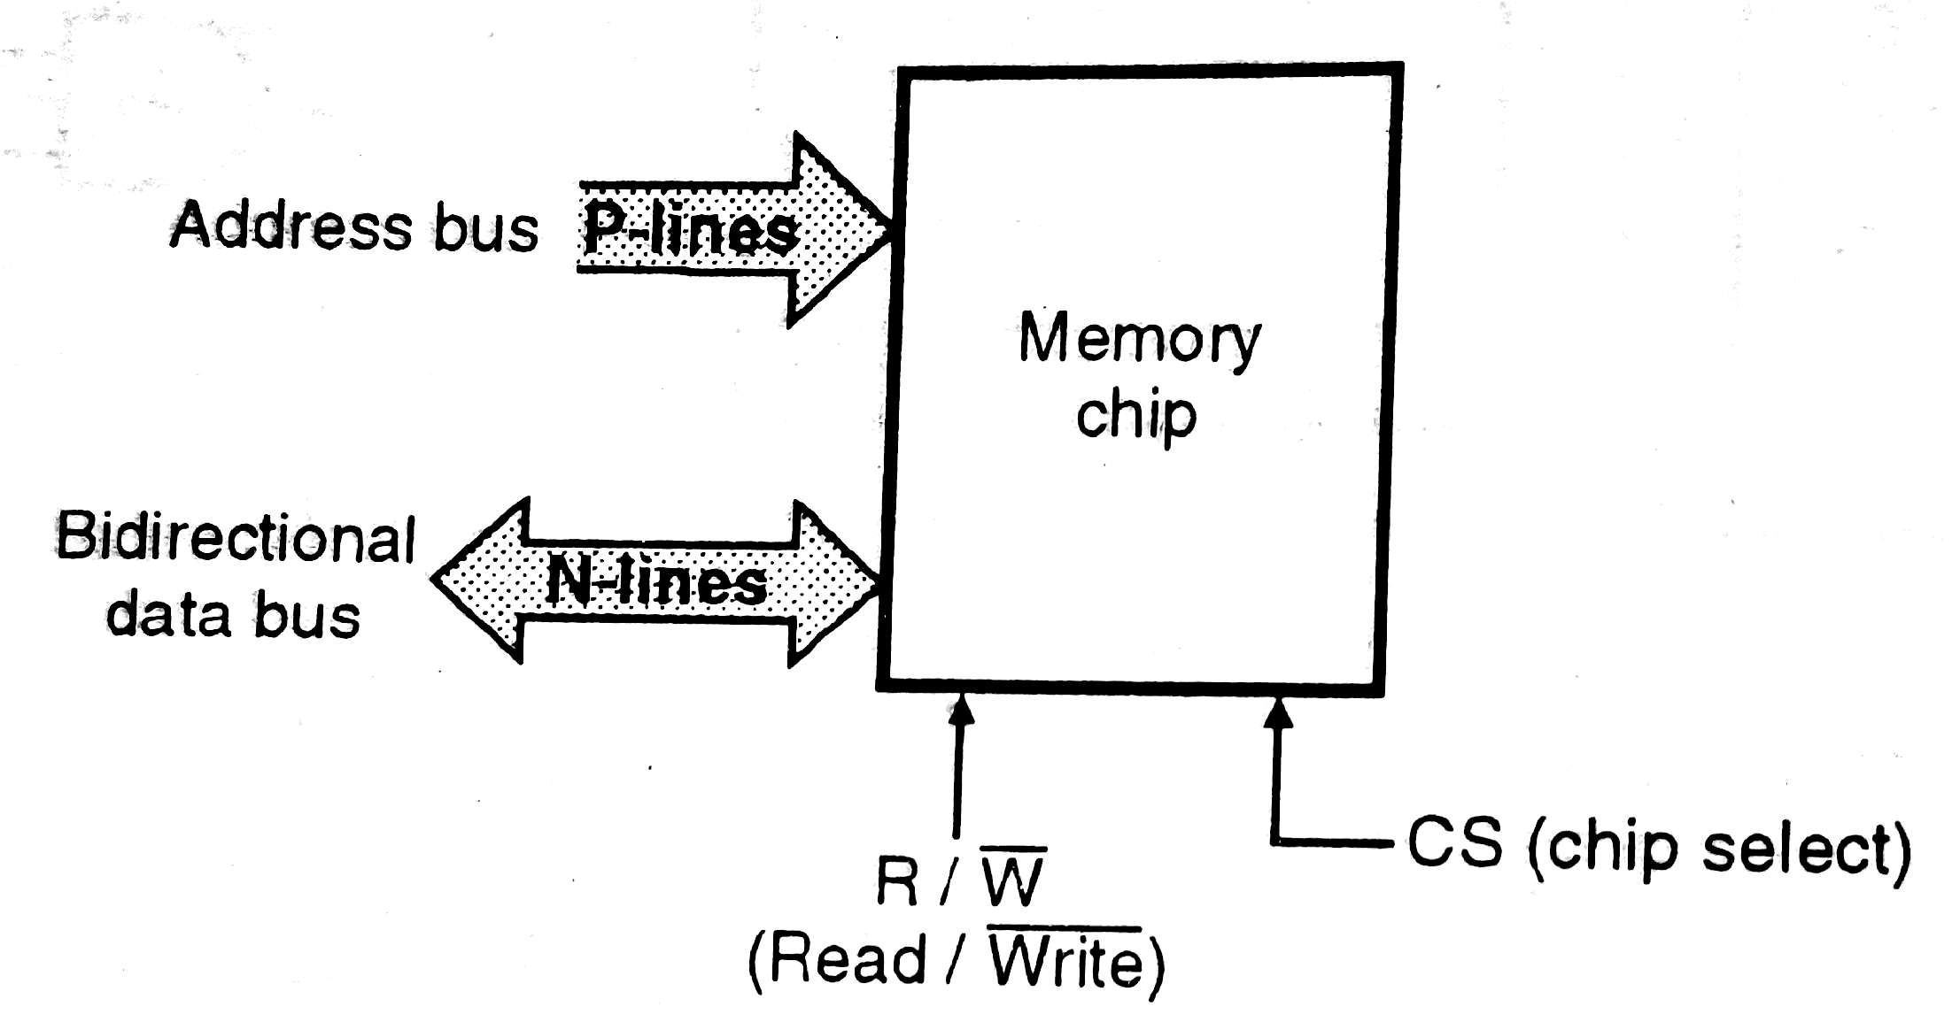
Memory chip with bi – directional data bus

Slide 9

Control Lines
The control lines include the read/write line and the chip select line (which acts as the enable input)
The bi – directional bus is used as input data bus for specific time when input data is to be loaded into the memory (Write Operation)
And it is used as output data bus for specific time when the stored data is be read (Read Operation)
The Bidirectional data bus saves ‘N’ data lines.
There is only one control line and it is denoted by line
If = 1, Reading operation takes place that means data bus acts as output data bus.
If = 0, Write operation takes place that means data bus acts as input data bus.
Chip Select line: The chip select input is active high input.
When CS = 1, then only the chip is enabled and reading or writing will take place

Slide 10
Classification of Memories
The memory devices can be classified, on the basis of various parameters. The parameters used as basis of classification are as follows:
Principle of Operation
Physical Characteristics
Mode of Access
Technology Used for fabrication

Slide 11
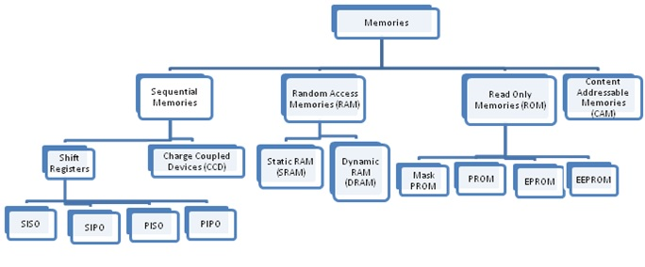
Classification of based on Principle of Operation

Slide 12
Sequential Memories
Sequential Memories: In these memories the memory locations are organized in a sequence (one after the other). The reading/writing from such memories is a sequential process. Hence the time required to access a memory location is different for different locations.
Examples: Magnetic tape audio/Video Cassette
The sequential memories are further classified into two types:
Shift Registers: already done in unit 5
Charge Coupled Devices (CCD)
The CCD are manufactured using MOS [Metal Oxide Semiconductor] technology
Advantages of CCD are high density and low cost

Slide 13
Random Access Memory (RAM or RWM)
The memory locations in this type of memory are organized in such a way that access time required for accessing any location is the same. This is the advantage of using RAM over the sequential Memories
RAM can be fabricated using either Bipolar technology or Unipolar technology
RAM is a volatile memory so it loses the stored data when power is turned OFF.
RAM also further classified into two types:
Static RAM (SRAM)
Dynamic RAM (DRAM)

Slide 14
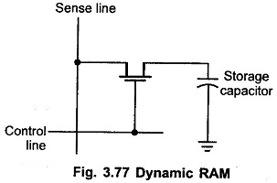
Types of RAM
Static RAM: SRAM cells are basically flip flops which can store a bit as long as power to the circuit is not interrupted.
SRAM possible to implement using the bipolar as well as MOS technology.
Dynamic RAM: In DRAM, the data is stored in the form of charge on the capacitor.
The Sense and control lines are used as column and row signals. When both these lines are high MOSFET acts as closed switch and charges the capacitor and when these lines are low, MOSFET turns OFF and capacitor retains its charge

Slide 15
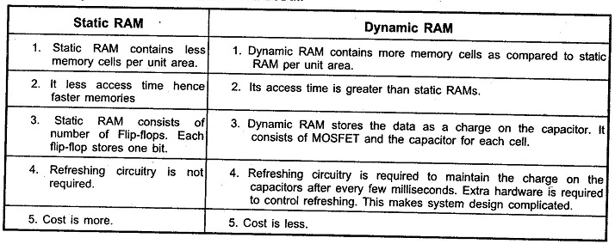
Comparison between SRAM and DRAM

Slide 16
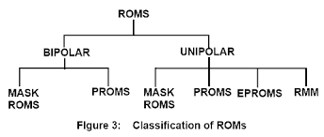
Read Only Memory (ROM)
These memories are designed only for reading the information which is already stored on them. The user cannot write any new information on them. These are similar to prerecorded cassettes.
A manufacturer or someone else can write ROM’s, but the writing process is much more complicated as compared to that of a RAM.
ROM is non - volatile memory such memories can hold the information even after switching off the power supply.
ROM also further classified as follows
Bipolar ROMs are faster and they have higher driving capabilities whereas MOS ROMs (Unipolar ROMs) require less area and consume less power.
Now a days we used only MOS ROMs which have improved speeds (typically equivalent to Bipolar ROMs

Slide 17
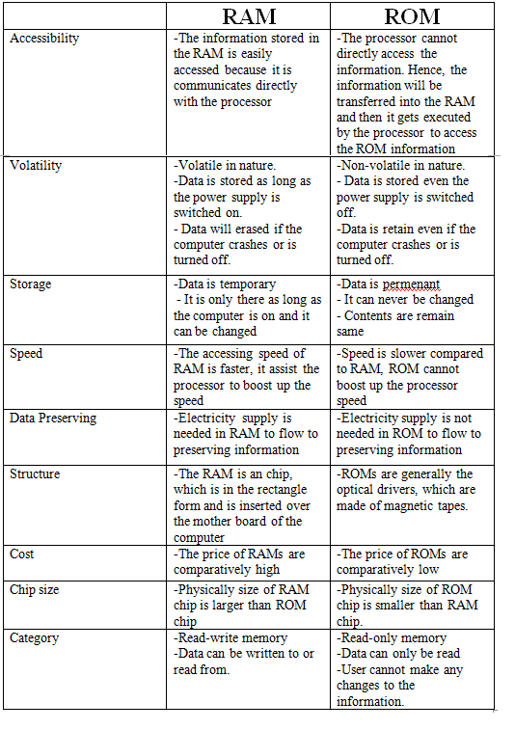
Comparison between RAM and ROM

